Slide 1

Policy Vacuums and Conceptual Muddles
Notes:
Testing notes

Slide 2

Policy Vacuums and Conceptual Muddles
A new technology appears.
A muddle: What sort of thing is it?
A policy vacuum: How should it be used, regulated, sold or whatever?
Notes:
One problem with the law: It isn’t always set up to deal with new technology.
https://pixabay.com/p-159109/?no_redirect EAR

Slide 3

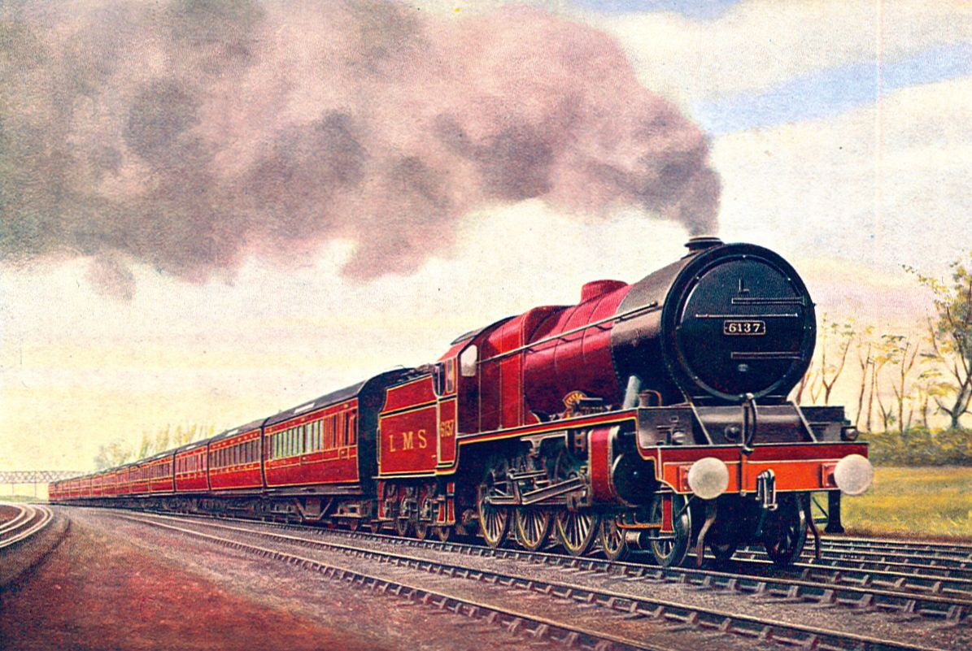

Common Carriers
Provide equal service to everyone.
Are not responsible for content.
Notes:
Three examples. Ask class what they have in common. Then click on Common Carriers. Ask them why we’re talking about this. Then go on to next slide.
https://proudamericans.org/the-pony-express/
https://en.wikipedia.org/wiki/Royal_Scot_(train)#/media/File:Royal_Scot,_6137_Vesta_(CJ_Allen,_Steel_Highway,_1928).jpg
https://beatriceco.com/bti/porticus/bell/images/hires_1939_logo.gif

Slide 4


Not Common Carriers
Notes:
https://www.britannica.com/topic/newspaper
https://www.myentertainmentworld.ca/2017/05/network-preview/

Slide 5


Vacuums and Muddles
Title I: Information services (e.g., websites)
Title II: Common carriers
Notes:
Policy implication: net neutrality. EAR
Good history: https://medium.com/@TebbaVonMathenstien/network-neutrality-a-history-of-common-carrier-laws-1884-2018-2b592f22ed2e
The FCC classified Internet Service Providers as common carriers, effective June 12, 2015, for the purpose of enforcing net neutrality
(Wikipedia) But this could always change. And it did.
https://transition.fcc.gov/files/logos/fcc-seal_black-large.png
http://www.bandwidthplace.com/comparing-different-types-of-internet-service-providers-article/

Slide 6
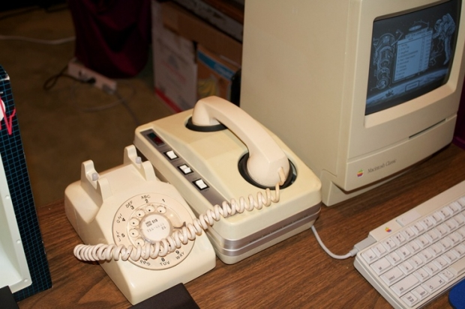
Vacuums and Muddles
The Internet appears. It is accessible by using a phone. The phone system is a common carrier.
But what about broadband?
1996 Telecommunications act silent, so little/no regulation
2002 : ISPs are categorized under Title I.
~2010: FCC tries to push for “net neutrality”
2014 D.C. Court of Appeals threw out the new rules.
2015: ISPs are categorized under Title II.
2016: D.C. Court of Appeals upheld net neutrality rules.
2017: Back to Title I.
Notes:
Policy implication: net neutrality. EAR
Early internet was by dialup, so no muddle. But what about high speed broadband?
2002 decision made clear there would be little regulation. Whenever the FCC tries to regulate, the telecoms sue. So, after about 20 years, it still isn’t settled. Key point: we have existing law for regulating and not regulating. We just need to decide which bucket this “new” technology belongs in.
Good history: https://medium.com/@TebbaVonMathenstien/network-neutrality-a-history-of-common-carrier-laws-1884-2018-2b592f22ed2e
The FCC classified Internet Service Providers as common carriers, effective June 12, 2015, for the purpose of enforcing net neutrality
(Wikipedia) But this could always change. And it did.
https://transition.fcc.gov/files/logos/fcc-seal_black-large.png
http://www.bandwidthplace.com/comparing-different-types-of-internet-service-providers-article/

Slide 7

A Muddle and a Vacuum
Computer programs become economically significant assets.
Policy vacuum: How should this intellectual property be protected?
Conceptual muddle: What is a program?
Is it text?
Is it an invention?
Is it mathematics?
Notes:
BTW: History suggests that eventually we’ll converge on an answer.
Answer: Software can be copyrighted and patented.
https://cdn.meritalk.com/wp-content/uploads/2016/10/code.jpg EAR
Other examples: Is email like a letter or a postcard? Are Google and Facebook websites or common carriers? Is your phone location data (CSLI) like the content of your calls (protected) or is it something else?
Are ecigs cigarettes, drug delivery vehicles or something else?
Is your phone (or laptop) protected like the contents of your head? But you incriminate yourself by surrendering your password?
Do you have privacy rights to data that third party companies have about you?

Slide 8
More Muddles and Vacuums?
Pause here and see if you can think of a couple more examples.
Think about new technologies and how they can be used.
Go on to the next slides for some that we have thought of.

Slide 9
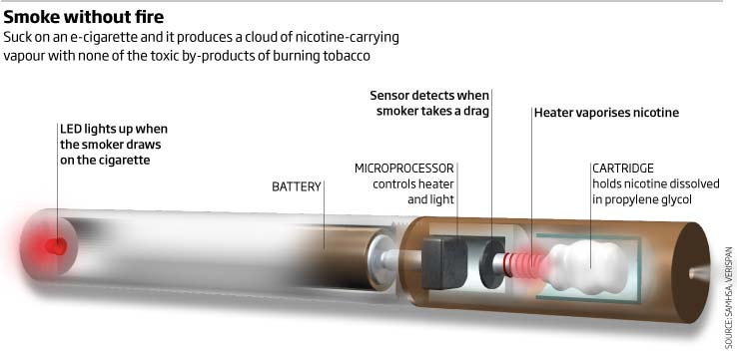
Vacuums and Muddles
E Cigs
Notes:
Interesting because muddles don’t just happen with things that look like computers.
http://www.e-cigarettedirect.com/pages/How-E-Cigs-Work.html

Slide 10
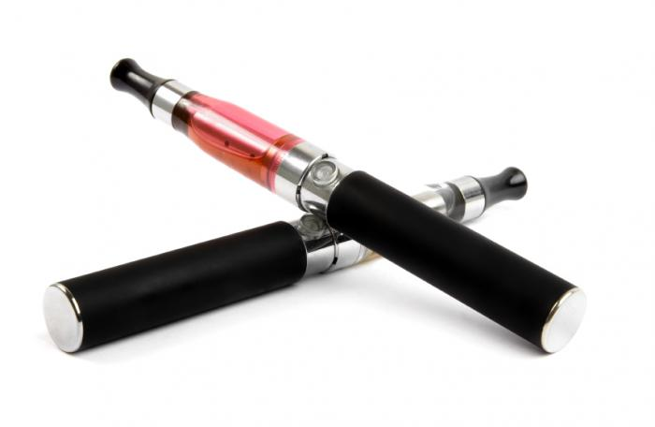
Vacuums and Muddles
E Cigs
Policy vacuum: How should they be regulated? Can they advertise? Who can buy them?
Conceptual muddle: What are they:
Cigarettes
Drug delivery vehicles
Something else
Notes:
2009: FDA bans import of unapproved drug delivery devices. Company says no. Then Family Smoking Prevention and Tobacco Control Act passed.FDA can regulate but not ban cigarettes. So company argued these are cigarettes. But now they want to be able to advertise.
http://www.nytimes.com/2013/10/27/business/the-e-cigarette-industry-waiting-to-exhale.html
Image: http://silverlightchallenge.eu/e-cigs-better-regular-ones/

Slide 11
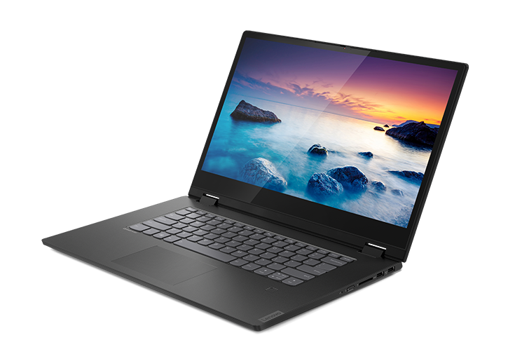
Vacuums and Muddles
Notes:
https://www.lenovo.com/us/en/laptops/ideapad/ideapad-flex-series/Lenovo-IdeaPad-FLEX-15IWL/p/88IP8FX1272

Slide 12
Vacuums and Muddles
The police confiscate your laptop, hoping to find incriminating evidence. But you’ve encrypted it.
Policy vacuum: Can the police force you to decrypt it?
Conceptual muddle:
Is giving up the password “testimony”? If so, the 5th Amendment protects you from being forced to “incriminate yourself”.
Or is giving it up an act (like being fingerprinted) If so, you can be forced to do it.
Notes:
http://www.wired.com/threatlevel/2012/01/judge-orders-laptop-decryption/
In Feb, 2012, the 10th U.S. Circuit Court of Appeals, upheld the January decision that a woman accused of mortgage fraud must decrypt her laptop.

Slide 13
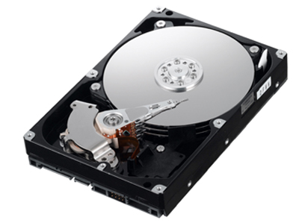

Your Encrypted Hard Drive
January 23, 2012: a Colorado U.S. District Judge, in a case against a woman accused of bank fraud, that the woman must decrypt her laptop. That decision was upheld by the 10th US Circuit Court of Appeals on February 22, 2012.
February 23, 2012: the 11th US Circuit Court of Appeals, in a case against a man accused of child pornography, ruled that forcing the man to decrypt his computer would be a breach of the Fifth Amendment.
Notes:
https://lawblog.legalmatch.com/2019/12/18/can-you-be-forced-to-disclose-your-computer-password-to-the-police/
http://www.wired.com/threatlevel/2012/01/judge-orders-laptop-decryption/
http://www.wired.com/threatlevel/2012/02/laptop-decryption-unconstitutional/
Disk image: http://www.zdnet.com/blog/doc/what-about-the-hard-drive-in-your-printer/1551
Picture to illustrate “back and forth”: http://www.acclaimclipart.com/free_clipart_images/boys_throwing_a_ball_back_and_forth_0515-1001-0204-0410.html

Slide 14
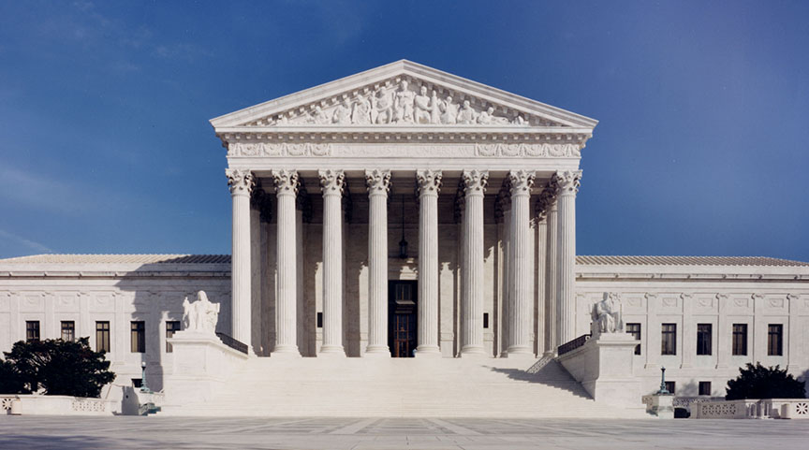
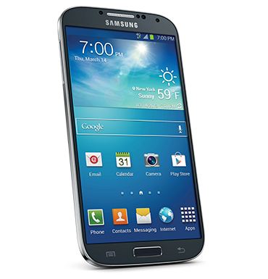
Privacy and Your Cell Phone
Is raw location data protected by your right to privacy?
Conceptual muddle: what is cell location?
Is it like the contents of your phone conversations?
Is it like pictures of you out and about?
Policy vacuum: Can the police get it without a warrant?
The Supreme Court ruled in 2018 in Carpenter v United States that the police need a warrant.
Notes:
Note: conceptual muddle: what is cell location data (is it the same as cell call content data)?
Policy vacuum: Can the police get it without a warrant?
https://pngimage.net/samsung-cell-phone-png/
https://www.supremecourt.gov/about/images/CourtBuilding.jpg

Slide 15

The Muddles and Vacuums Lens is Useful

